Slide 1
Topics of the Day
Revision
A Typical Hadoop Cluster
Hadoop Cluster Configuration
Hadoop Configuration Files
Hadoop Cluster Modes
Sample example list in Hadoop
Running Teragen Example
Dump of MR job
Data Loading Techniques
Using Hadoop Copy Commands
FLUME
SQOOP
Course Project Problem Statement

Slide 2











Let’s Revise
Hadoop Core Components
HDFS Architecture
What is HDFS?
Hadoop Vs. Traditional Systems
MapReduce Engine
Job Tracker
Task Tracker
Task Tracker
Task Tracker
Task Tracker
5. NameNode and Secondary
NameNode
HDFS
Cluster
Admin Node
NameNode
DataNode
DataNode
DataNode
DataNode

Slide 3



















Hadoop Cluster Architecture
Master
Slave01 DaStlaaNvoed0e 2 TasDkaTtraaSNclkaoevdree03
TaskTDraaStcaklNaeorvdee04 Task_{D}T_{a}rSa_{ta}cl_{N}kae_{o}vr_{d}e_{e}05
TaskDTaratacNkeorde TaskTracker
NameNode http://master:50070/
JobTracker
http://master:50030/

Slide 4
























Hadoop Cluster Architecture ( Contd.)
Client
HDFS
NameNode
Map Reduce
JobTracker
DataNode
DataNode
TaskTracker
TaskTracker
TaskTracker
TaskTracker
DataNode
DataNode
DataNode
DataNode
TaskTracker
TaskTracker
TaskTracker
TaskTracker
DataNode
DataNode

Slide 5




Annie’s Question
The default replication factor is:
2
4
5
3
Hello There!! My name is An
I love quizzes and
and here make you guys think and
answer my questions.

Slide 6

Annie’s Answer
The answer is c. It means if you move a file to hdfs then by default 3 copies of the file will be stored on different datanodes.

Slide 7

Annie’s Question
Every Slave node has two daemons running on them that is DataNode and TaskTracker in a MultiNode Cluster.
TRUE
FALSE

Slide 8

Annie’s Answer
TRUE. DataNode service for HDFS and TaskTracker for processing (MapReduce) tasks.

Slide 9

Annie’s Question
A block is replicated in 4 nodes K,L,M, and N. If M, K and N fails. A client can still read the data.
TRUE
FALSE
Hello There!! My name is An
I love quizzes and
and here make you guys think and
answer my questions.

Slide 10
Annie’s Answer
TRUE. As the remaining node ‘L’ will contain the block in question.

Slide 11














Hadoop Cluster: A Typical Use Case
NameNode
RAM: 64 GB,
Hard disk: 1 TB
Processor: Xenon with 8 Cores Ethernet: 3 X 10 GB/s
OS: 64-bit CentOS
Power: Redundant Power Supply
Secondary NameNode
RAM: 32 GB,
Hard disk: 1 TB
Processor: Xenon with 4 Cores Ethernet: 3 X 10 GB/s
OS: 64-bit CentOS
Power: Redundant Power Supply
DataNode
RAM: 16GB
Hard disk: 6 X 2TB
Processor: Xenon with 2 cores. Ethernet: 3 X 10 GB/s
OS: 64-bit CentOS
DataNode
RAM: 16GB
Hard disk: 6 X 2TB
Processor: Xenon with 2 cores. Ethernet: 3 X 10 GB/s
OS: 64-bit CentOS

Slide 12

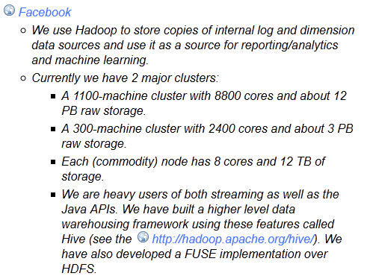
Hadoop Cluster: Facebook
http://wiki.apache.org/hadoop/PoweredBy

Slide 13





Hadoop Cluster Modes
Hadoop can run in any of the following three modes:
Standalone (or Local) Mode
No daemons, everything runs in a single JVM.
Suitable for running MapReduce programs during development.
Has no DFS.
Pseudo-Distributed Mode
Hadoop daemons run on the local machine.
Fully-Distributed Mode
Hadoop daemons run on a cluster of machines.

Slide 14
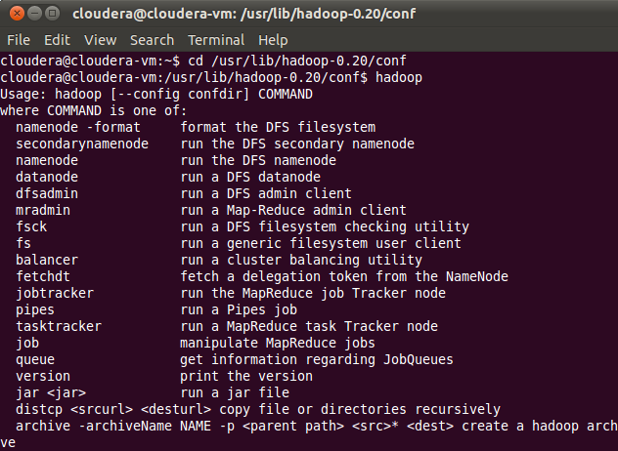
Terminal Commands

Slide 15

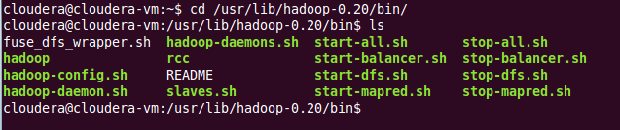
Terminal Commands
Listing of files present on HDFS
Listing of files present in bin Directory

Slide 16
Hadoop Configuration Files
Configuration Filenames | Description of Log Files
hadoop-env.sh | Environment variables that are used in the scripts to run Hadoop.
core-site.xml | Configuration settings for Hadoop Core such as I/O settings that are common to HDFS and MapReduce.
hdfs-site.xml | Configuration settings for HDFS daemons, the namenode, the secondary namenode and the data nodes.
mapred-site.xml | Configuration settings for MapReduce daemons : the job-tracker and the task-trackers.
masters | A list of machines (one per line) that each run a secondary namenode.
slaves | A list of machines (one per line) that each run a datanode and a task-tracker.

Slide 17
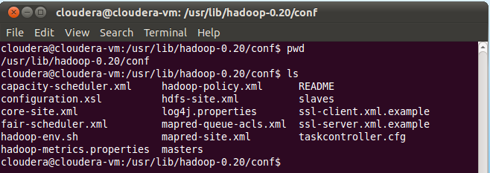
Hadoop 1.x Configuration Files – CDH3

Slide 18

















Hadoop 1.x Configuration Files – CDH3
Core
core-site.xml
HDFS
hdfs-site.xml
Map Reduce
mapred-site.xml

Slide 19
core-site.xml and hdfs-site.xml
hdfs-site.xml | core-site.xml
<?xml version - "1.0"?> | <?xml version ="1.0"?>
<!--hdfs-site.xml--> | <!--core-site.xml-->
<configuration> | <configuration>
<property> | <property>
<name>dfs.replication</name> | <name>fs.default.name</name>
<value>1</value> | <value>hdfs://localhost:8020/</value>
</property> | </property>
</configuration> | </configuration>

Slide 20
Defining HDFS Details In hdfs-site.xml
Property | Value | Description
dfs.data.dir | <value> /disk1/hdfs/data, /disk2/hdfs/data </value> | If this is a comma-delimited list of directories, then data will be stored in all named directories, typically on different devices. ${hadoop.tmp.dir}/dfs/data
fs.checkpoint.dir | <value> /disk1/hdfs/namesecondary, /disk2/hdfs/namesecondary </value> | A list of directories where the secondary namenode stores checkpoints. It stores a copy of the checkpoint in each directory in the list ${hadoop.tmp.dir}/dfs/namesecondary

Slide 21
mapred-site.xml
mapred-site.xml
<?xml version=“1.0”?>
<configuration>
<property>
<name>mapred.job.tracker</name>
<value>localhost:8021</value>
<property>
</configuration>

Slide 22
Defining mapred-site.xml
Property | Value | Description
mapred.job.tracker | <value> localhost:8021 </value> | The hostname and the port that the jobtracker RPC server runs on. If set to the default value of local, then the jobtracker runs in-process on demand when you run a MapReduce job.
mapred.local.dir | ${hadoop.tmp.dir}/mapred/local | A list of directories where MapReduce stores intermediate data for jobs. The data is cleared out when the job ends.
mapred.system.dir | ${hadoop.tmp.dir}/mapred/syste m | The directory relative to fs.default.name where shared files are stored, during a job run.
mapred.tasktracker.map.tasks. maximum | 2 | The number of map tasks that may be run on a tasktracker at any one time
mapred.tasktracker.reduce.tasks .maximum | 2 | The number of reduce tasks tat may be run on a tasktracker at any one time.

Slide 23
All Properties
http://hadoop.apache.org/docs/r1.1.2/core-default.html
http://hadoop.apache.org/docs/r1.1.2/mapred-default.html
http://hadoop.apache.org/docs/r1.1.2/hdfs-default.html

Slide 24


Slaves and Masters
Two files are used by the startup and shutdown commands:
Slaves
Contains a list of hosts, one per line, that are to host DataNode and
TaskTracker servers.
Masters
Contains a list of hosts, one per line, that are to host Secondary NameNode servers.

Slide 25







Per-Process RunTime Environnent
Set parameter JAVA_HOME
hadoop-env.sh
JVM
This file also offers a way to provide custom parameters for each of the servers. Hadoop-env.sh is sourced by all of the Hadoop Core scripts provided | in the conf/ | directory of the
installation.
Examples of environment variables that you can specify:
export HADOOP_DATANODE_HEAPSIZE="128"
export HADOOP_TASKTRACKER_HEAPSIZE="512"

Slide 26
Web UI URLs
NameNode status: http://localhost:50070/dfshealth.jsp
JobTracker status: http://localhost:50030/jobtracker.jsp
TaskTracker status: http://localhost:50060/tasktracker.jsp
DataBlock Scanner Report: http://localhost:50075/blockScannerReport

Slide 27

Annie’s Question
Which of the following file is used to specify the NameNode's heap size?
bashrc
hadoop-env.sh
hdfs-site.sh
core-site.xml

Slide 28

Annie’s Answer
hadoop-env.sh. This file specifies environment variables that affect the JDK used by Hadoop Daemon (bin/hadoop).

Slide 29

Annie’s Question
It is necessary to define all the properties in core-site.xml, hdfs-site.xml & mapred-site.xml.
TRUE
FALSE

Slide 30
Annie’s Answer
False. Detailed answer will be give after the next question.

Slide 31

Annie’s Question
Stand alone Mode uses default configuration?
TRUE
FALSE

Slide 32

Annie’s Answer
True. In Stand alone mode Hadoop runs with default configuration (Empty configuration files i.e. no configuration settings in core-site.xml, hdfs-site.xml, and mapred-site.xml). If properties are not defined in the configuration files, hadoop runs with default values for the corresponding properties.

Slide 33










Hadoop Cluster: Password-Less SSH
Hadoop Core
Requires password- less SSH connection between the master and all the slaves and secondary machines
Uses Shell (SSH) to launch the server processes on the slave nodes

Slide 34

Annie’s Question
If Password-less SSH Login is not set-up among nodes,
Hadoop deamons won't start
Only NameNode will start in Master
User's password has to be entered to start every daemon
None of these

Slide 35
Annie’s Answer
Answer is (C), User password is required to start the daemons.

Slide 36

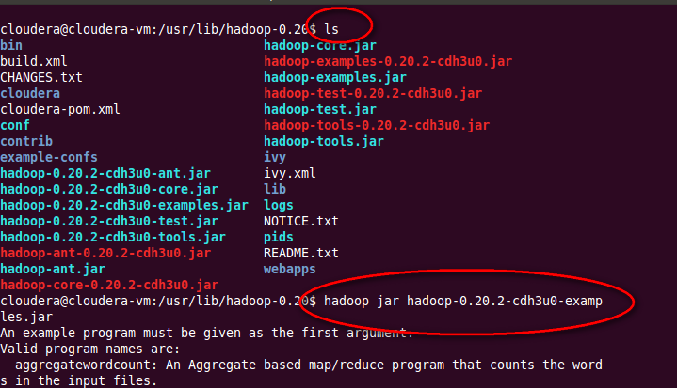
Sample Examples List

Slide 37
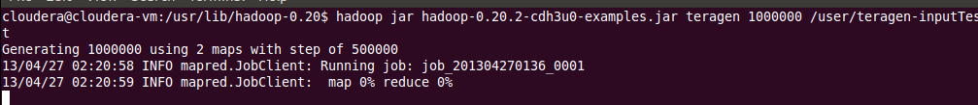

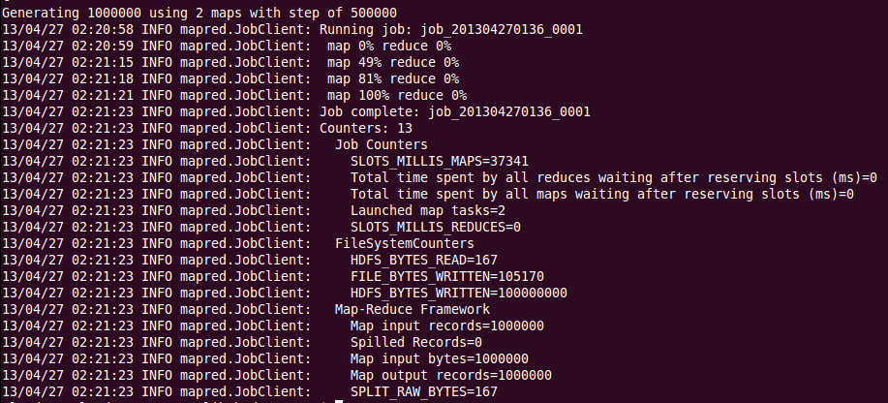
Running the Teragen Example

Slide 38

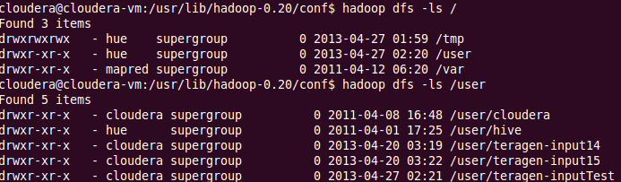
Checking the Output

Slide 39

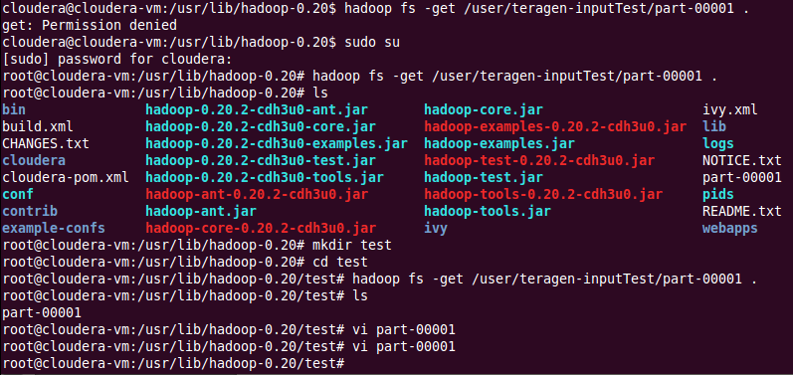
Checking the Output

Slide 40


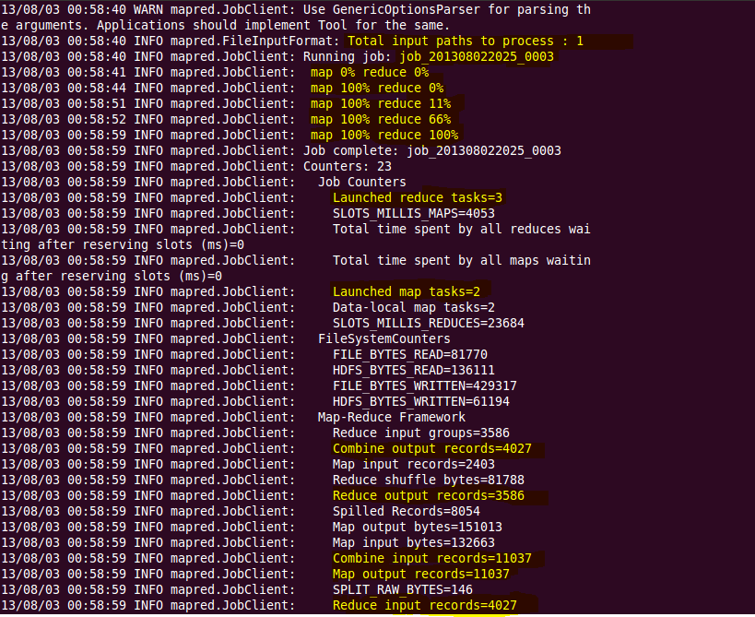
Dump of a MR Job

Slide 41
Dump of a MR Job

Slide 42

Dump of a MR Job

Slide 43
Dump of a MR Job

Slide 44

Annie’s Question
The output of a MR job will be stored on HDFS:
TRUE
FALSE

Slide 45

Annie’s Answer
True. It is stored in different part files for eg – part-m-00000, part-m-00001 and so on. The part files are created on the basis of the block size.

Slide 46

Annie’s Question
To run MR job data should be present on HDFS:
TRUE
FALSE

Slide 47

Annie’s Answer
True. In order to process data in parallel it is necessary that it is present on HDFS so that MR can work on chunks of data in parallel.

Slide 48





















Data Loading Techniques and Data Analysis
Data Analysis
Using Pig
Using HIVE
HDFS
Using Flume
Using Sqoop
Using Hadoop Copy Commands
Slide 51
Data Loading
www.Hadoop.in/hadoop

Slide 49

Hadoop Copy Commands
put: Copy file(s) from local file system to destination file system. It can also read from “stdin” and writes to destination file system.
hadoop dfs –put weather.txt hdfs://<target Namenode>
copyFromLocal: Similar to “put” command, except that the source is restricted to a local file reference.
hadoop dfs –copyFromLocal weather.txt hdfs://<target Namenode>
distcp: Distributed Copy to move data between clusters, used for backup and recovery
hadoop distcp hdfs://<source NN> hdfs://<target NN>

Slide 50









Data Loading Using Flume
Flume is a distributed, reliable, and available service for efficiently collecting, aggregating, and moving large amounts of streaming event data.
Twitter Streaming API
HDFS
Flume
Twitter Source
HDFS
Sink
Memory Channel

Slide 51

Data Loading Using Sqoop
Apache Sqoop (TM) is a tool designed for efficiently transferring bulk data between Apache Hadoop and structured data stores such as relational databases.
Imports individual tables or entire databases to HDFS.
Generates Java classes to allow you to interact with your imported data.
Provides the ability to import from SQL databases straight into
your Hive data warehouse.

Slide 52

Annie’s Question
Your website is hosting a group of more than 300 sub-websites. You want to have an analytics on the shopping patterns of different visitors? What is the best way to collect those information from the weblogs?
SQOOP
FLUME

Slide 53
Annie’s Answer
FLUME.

Slide 54



Annie’s Question
You want to join data collected from two sources. One source of data collected from a big database of call records is already available in HDFS. The another source of data is available in a database table. The best way to move that data in HDFS is:
SQOOP import
PIG script
Hive Query

Slide 55
Annie’s Answer
SQOOP import.

Slide 56





Use Case – How do I find out the best?

Slide 57
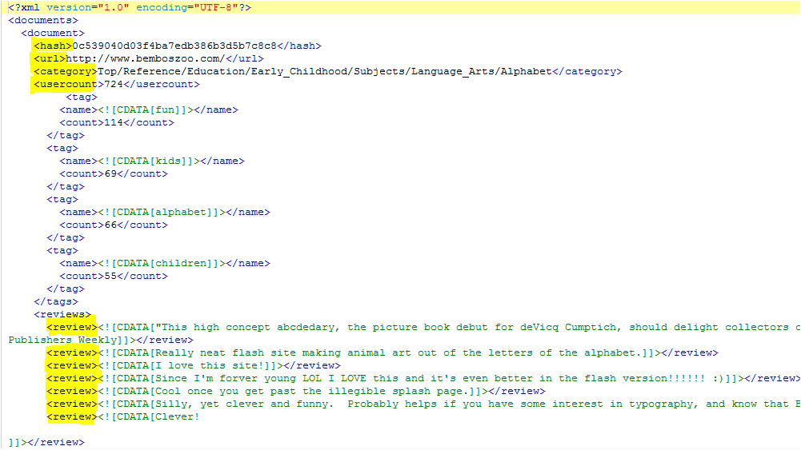


Use Case – Data to Analyse

Slide 58












Abstract Flow Diagram
Huge Raw XML files with unstructured data line reviews
User Interface To search the top rated links per category

Slide 59









Flow Diagram
User Interface To search the top rated links per category
SQOOP
PIG
HIVE
HDFS
Huge Raw XML files
with unstructured data line reviews

Slide 60
Data Load for Course Project
Demo for Data Load

Slide 61

Further Reading
Hadoop Cluster Setup http://hadoop.apache.org/docs/r0.19.1/cluster_setup.html
Hadoop on Amazon AWS ec2
http://www.Hadoop.in/blog/install-apache-hadoop-cluster/
Hadoop Hardware Selection
http://blog.cloudera.com/blog/2013/08/how-to-select-the-right-hardware-for- your-new-hadoop-cluster/
http://docs.hortonworks.com/HDPDocuments/HDP1/HDP-Win-1.3.0/bk_cluster- planning-guide/content/ch_hardware-recommendations.html
Hadoop Cluster Configuration http://www.Hadoop.in/blog/hadoop-cluster-configuration-files/

Slide 62
Further Reading
MapReduce Job execution
http://www.Hadoop.in/blog/anatomy-of-a-mapredcue-job-in-apache-hadoop/
Add/Remove Nodes in a Cluster
http://www.Hadoop.in/blog/commissioning-and-decommissioning-nodes-in-a-hadoop-
cluster/
Secondary Namenode https://hadoop.apache.org/docs/r1.2.1/hdfs_user_guide.html#Secondary+NameNode

Slide 63
Pre-work
Setup the Hadoop development environment using the documents present in the LMS.
Flume Set-up on Cloudera
SQOOP Set-up on Cloudera
Refresh your Java Skills using Java Essential for Hadoop Tutorial
Attempt the Module-2 Assignments present in the LMS.
Review the Interview Questions for setting up hadoop cluster
http://www.Hadoop.in/blog/hadoop-interview-questions-hadoop-cluster/

